Slide 1
Topics to be covered are: Word problems based on long division method Square root of a rational number Squares of terminating decimals

Slide 2
WORD PROBLEMS BASED ON LONG DIVISION METHOD
LINK: https://www.youtube.com/watch?v=tBO9yIIwcj0

Slide 3
LINK: https://www.youtube.com/watch?v=a7pMNR0wtT8

Slide 4
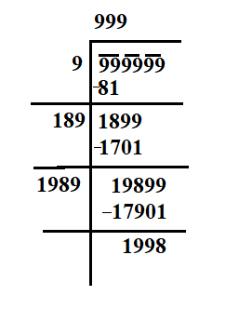
WS-4(QUE-3)
Find the greatest number of six digits which is a perfect square. Find the square root of the number obtained.
Solution:
Greatest 6 digits number = 999999
Remainder = 1998
Hence, we must subtract 1998 from 999999 to get a
perfect square.
Required greatest 6 digit number
= 999999 -1998 = 998001
and √998001 = 999

Slide 5
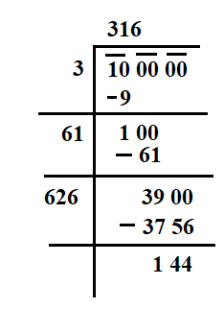
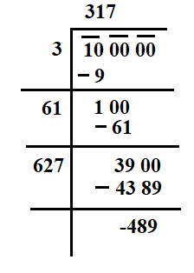
WS-4
QUE-5 Find the least number of six digits which is a perfect square. Find the square root of the number obtained.
So, (316)² < 100000 < (317)²
Or, 100000 is 489 less than (317)²
Hence, 489 must be added to 100000 to get a perfect square.
Therefore, Required least 6 digit number
= 100000 + 489 = 100489
and √100489 = 317

Slide 6
Homework WS- 4
Q2. Find the least number which must be subtracted from 6203 to obtain a perfect square. Find the square root of the number obtained.
Q4 Find the least number which must be added to 6203 to obtain a perfect square. Find the square root of the number obtained.
Q6. Find the value of √(64432729) - √(9653449)

Slide 8
WS-5 Q1Find the square root of the following fractions:

Slide 9
(iii)

Slide 13
Q2 Find the value of

Slide 15
HOMEWORK(Worksheet-5)
Q1) Find the square root of the following fractions:
(ii)$\frac{441}{961} (iv)21\frac{51}{169}$
(vi) 7$\frac{18}{49} (viii)$ 35$\frac{85}{1444}$
Q2) Find the value of:
(ii) √0.0081 (iv) √7.29

